Slide 1
Using KNN to Identify Glass
By Andrew Craig, CSE 5160 Fall 2021

Slide 2
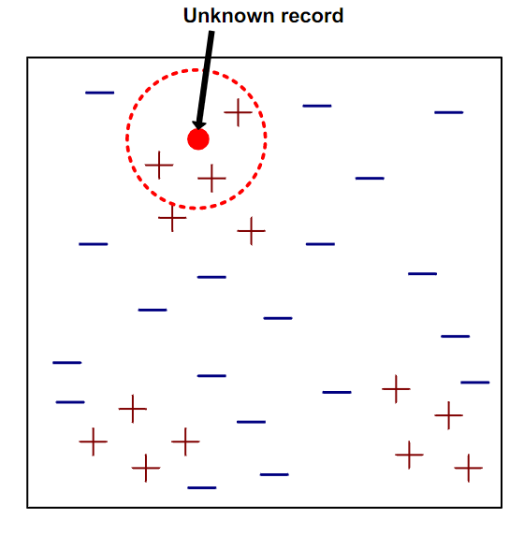
KNN algorithm
KNN stands for K-Nearest Neighbors
Supervised Learning algorithm
KNN Classifies and unknown instance of data
It does this by:
Computing the distance to other training instances
Identifies k nearest neighbors
Uses the class labels of nearest neighbors to determine the class label of the unknown instance

Slide 3
Choosing a value for K
If K is too small, it is sensitive to noise points
If K is too large, the neighborhood may include points from other classifiers
Odd values of K are used to prevent ties
Rule of thumb for choosing K is to use the square root of the size of the training set

Slide 4
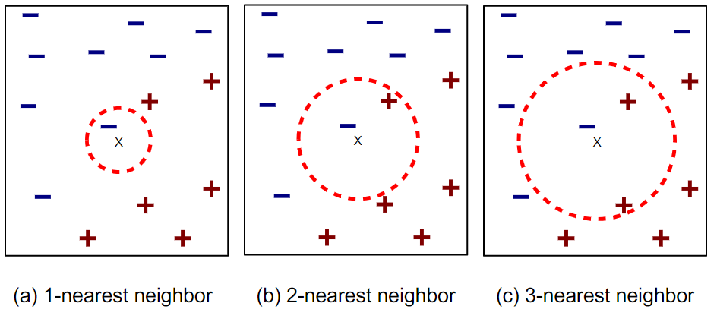
Choosing a value for K Cont.

Slide 5
The Data set
UCI Machine learning Repository
214 instances of data
10 attributes:
Id number: 1 to 214
RI: refractive Index
Na: Sodium (Weight Percent for the elements)
MG: Magnesium
Al: Aluminum
Si: Silicon
K: Potassium
Ca: Calcium
Ba: Barium
Fe: Iron

Slide 6
The Data Set Cont.
Classification (Type of glass):
Building windows float processed
Building windows non float processed
Vehicle windows float processed
Vehicle windows non float processed
Containers
Tableware
Headlamps

Slide 7
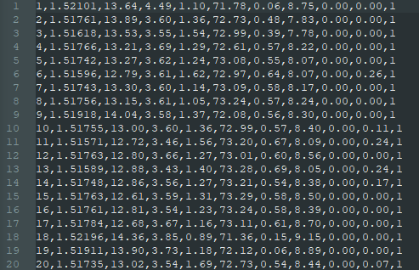
The Data Set Cont.

Slide 8
The Program
Programed in Python 3 version 3.8.12
Breaks the data set into two sets:
Training set (80% of the data, 171 instances)
Test set (20% of the data, 43 instances)
Used two ways to handle tie breakers:
The mode of the classifications for the training set (Mode tiebreak)
The first mode in the multimode for the specific instance of data (Multimode tiebreak)
Since classification of the test set is known the program calculates the accuracy of the KNN algorithm

Slide 9
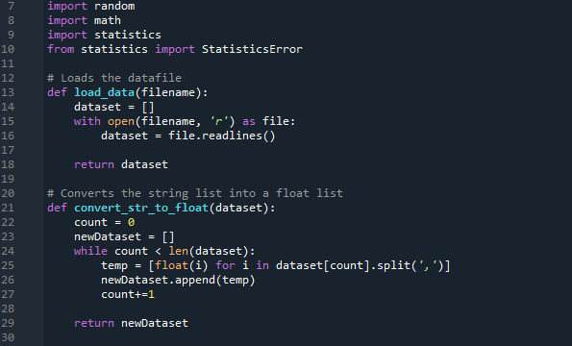
The Code

Slide 10
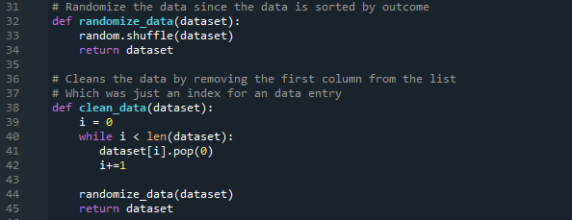
The Code cont.

Slide 11
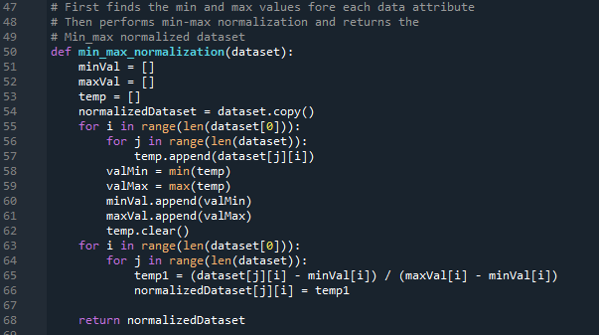
The Code cont.

Slide 12
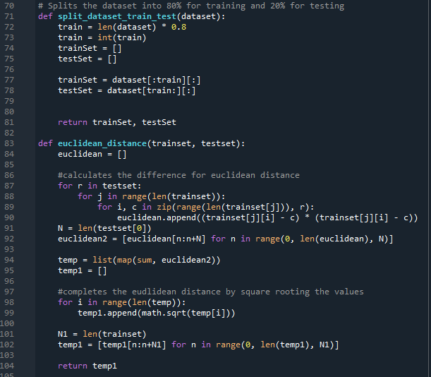
The Code cont.

Slide 13
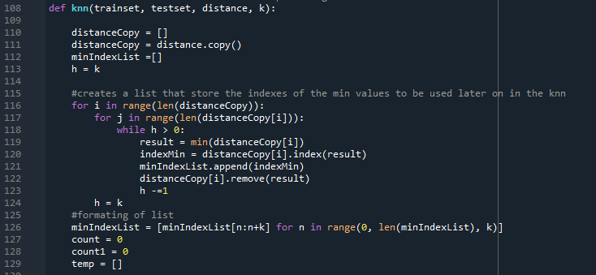
The Code cont.

Slide 14
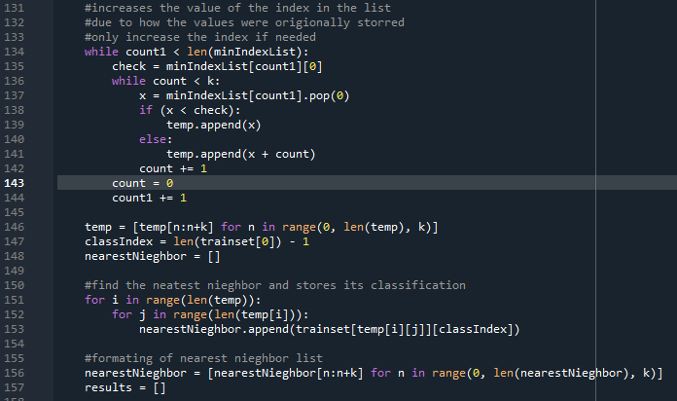
The Code Cont.

Slide 15
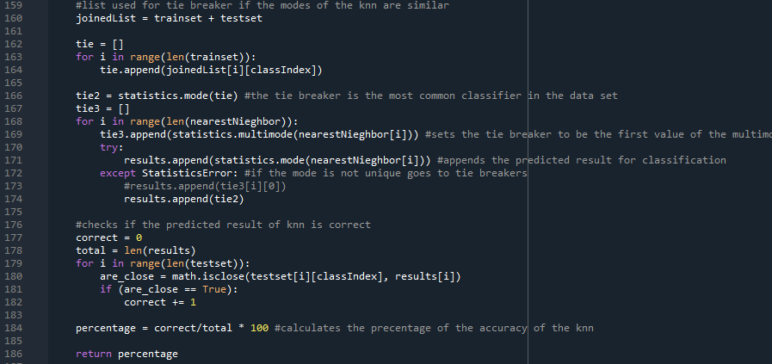
The Program Cont.

Slide 16
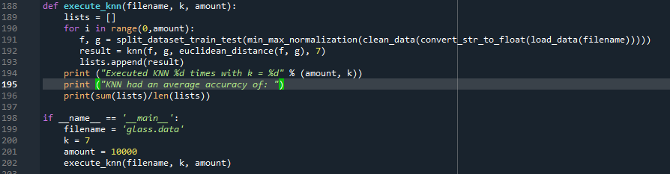
The Program cont.

Slide 17
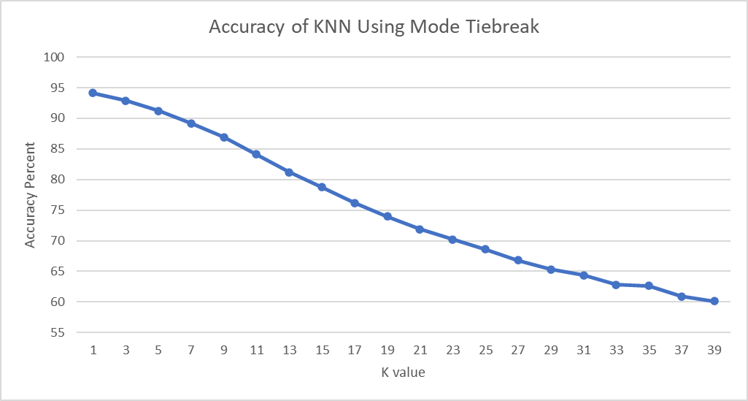
Results

Slide 18
Results cont.

Slide 19
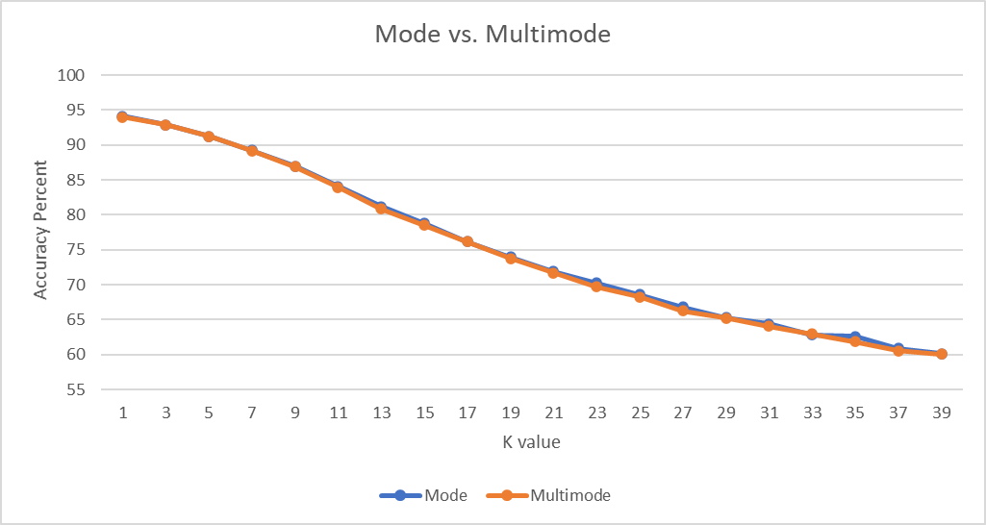
Results cont.

Slide 20
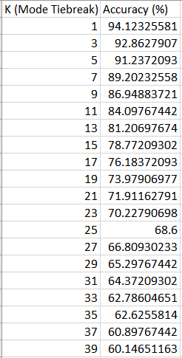
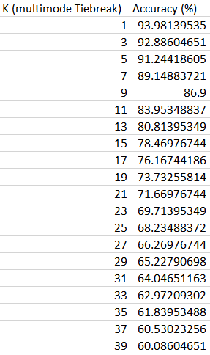
Results cont.

Slide 21
Any Questions?

